Slide 1

www.studymafia.org
Seminar
On
Online Voting System
Submitted To: Submitted By:
www.studymafia.org www.studymafia.org

Slide 2
TABLE OF CONTENT
S.No | Topic
1. | Abstract
2. | Software Requirements
3. | HardWare Requirements
4. | About working
5. | Goals of Proposed System
6. | Online Voting contains:
7. | Various Operation
8. | User Characteristics
9. | Advantages
10. | Modules
11. | Screen Shots
12. | Conclusion

Slide 3
ABSTRACT (i)
We are developing an on-line voting system by taking advantage of the centralized database with a web interface. The main concept of this project is to build a website, which should be able to allow people to cast their vote by online.
Time saving, working load reduced, information available at time and it provide security for the data. During the election, the election commission of India has introduced a new method of polling by online voting system (OVS). The election commission will maintain this website.

Slide 4
ABSTRACT (ii)
This is a simple, safe and secure method that takes minimum of time. We proceed our project with the assumption that each voter has a voter ID storing his/her unique identity including data.,
We are to maintain a centralized database of enrolled voters, the primary key of which is a unique national ID stored on the database. The database administrator is the control the website. Control of the process is entirely in the hands of the computer, and cannot be manipulated by any others.

Slide 5
ABSTRACT (iii)
Integrity of the results is guaranteed; Preventing the chance of false voting (i e) high secured false proof voting. Generally voting has to be performing by user by going to the voting center.
Many users like army person or NRI cannot come to the voting place. Therefore we have to implement a online voting system by which the users can vote over the online. It is one of the greatest advantage for NRI and person who go outside the country they can vote on online by our software.

Slide 6
Software Requirements
Operating System : Windows 7 Ultimate
Web Development Platform : ASP . NET 4.0
Back-end : Microsoft SQL server 2012
Browser : Mozilla Firefox

Slide 7
Hardware Requirement
Intel Pentium or and processors with speed minimum T4300,(2.10Ghz)
Minimum 1GB RAM.
Accelerated graphics card.
Minimum 50MB hard disk.
Better performance with 2.10ghz and above cache memory

Slide 8
ABOUT THE PROJECT
This is a simple, safe and secure method that take
minimum of time.
By developing website which will be solution to this problem. The election commissioner will maintain this website.
Once a person cast his/her vote, with proper authentication the revoting will be prohibited. Once the voting is over, all the counting will be done online and result will be displayed.
This method of web voting can provide security and no proxy voting can be done.

Slide 9
PROPOSED SYSTEM (i)
Planned approach towards working: - The working in the organization will be well planned and organized. The data will be stored properly in data stores, which will help in retrieval of information as well as its storage.
2. Accuracy: - The level of accuracy in the proposed system will be higher. All operation would be done correctly and it ensures that whatever information is coming from the center is accurate.

Slide 10
PROPOSED SYSTEM (ii)
3. Reliability: - The reliability of the proposed system will be high due to the above stated reasons. The reason for the increased reliability of the system is that now there would be proper storage of information.
4. No Redundancy: - In the proposed system utmost care would be that no information is repeated anywhere, in storage or otherwise. This would assure economic use of storage space and consistency in the data stored.

Slide 11
PROPOSED SYSTEM (iii)
5. Immediate storage of information: - In manual system there are many problems to store the largest amount of information.
6. Easy to Operate: - The system should be easy to operate and should be such that it can be developed within a short period of time and fit in the limited budget of the user.

Slide 12
ONLINE VOTING SYSTEM contains-:
Voter’s information in database.
Voter’s Names with ID.
Voter’s vote in a database.
Calculation of total number of votes.

Slide 13
Various operational works that are done in the system are:-
Recording information of the Voter in Voter database.
Checking of information filled by voter.
Discard the false information.
Each information is sent to ELECTION COMMISSION OF INDIA.

Slide 14
User Characteristics
Every user should be:
Comfortable with Internet Browser.
He must have brief knowledge of voting system.
He must also have basic knowledge of English too.
Constraints
GUI(Graphics User Interface) is only in English.
voterID and password is used for identification of Voter.

Slide 15
ADVANTAGES
Time saving.
Working load reduced.
Information available at time.
It provide security for the data.

Slide 16
MODULES FOR ONLINE VOTING
ABOUT FORM
VOTING REGISTER FORM
VOTING CITIZEN FORM
VOTING POLLING FORM
VOTING CANDIDATE REGISTER FORM
VOTING CANDIDATE DETAILS FORM
VOTING RESULT FORM
VOTING CONFIRMATION FORM

Slide 17
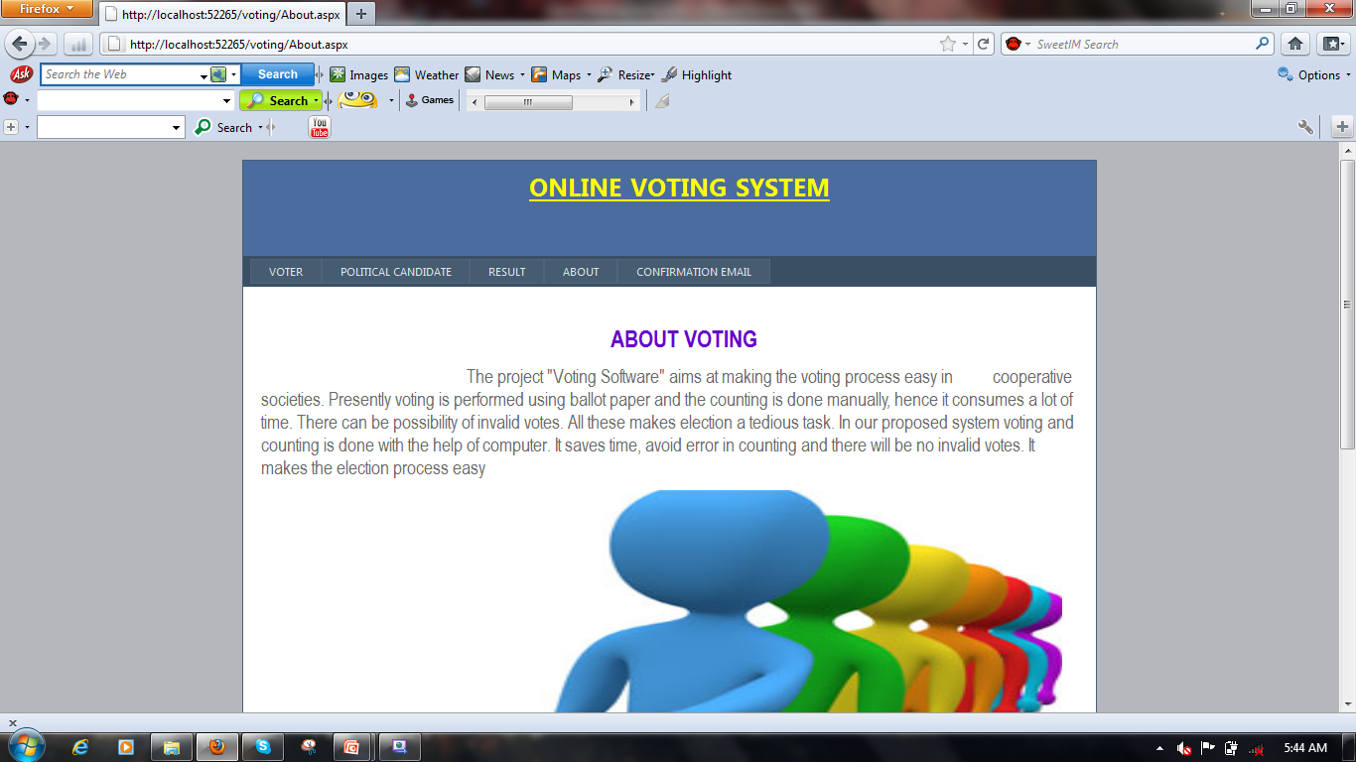
ABOUT FORM

Slide 18
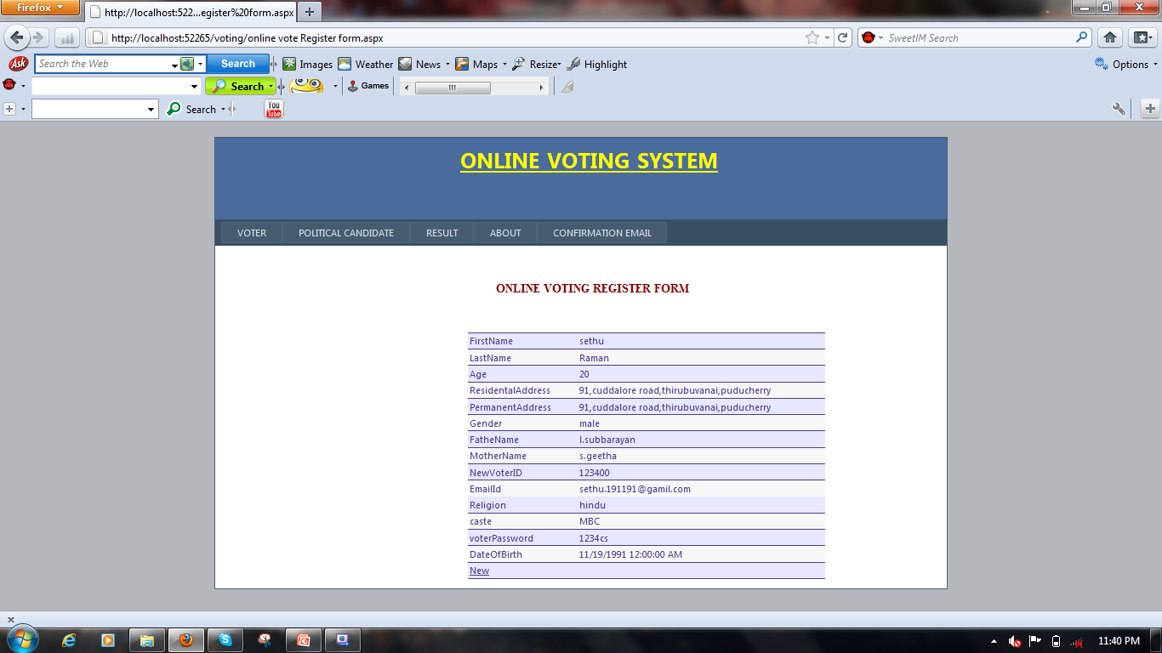
ONLINE VOTING REGISTER FORM

Slide 19
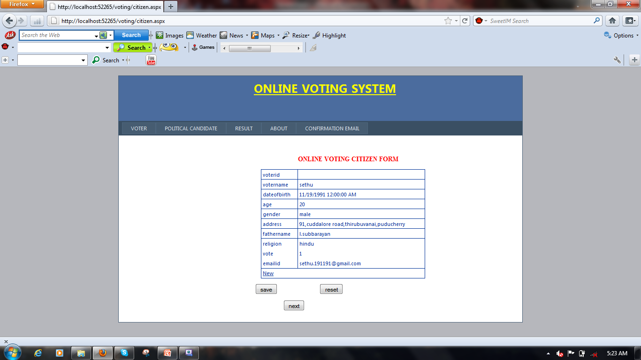
ONLINE VOTING CITIZEN FORM

Slide 20
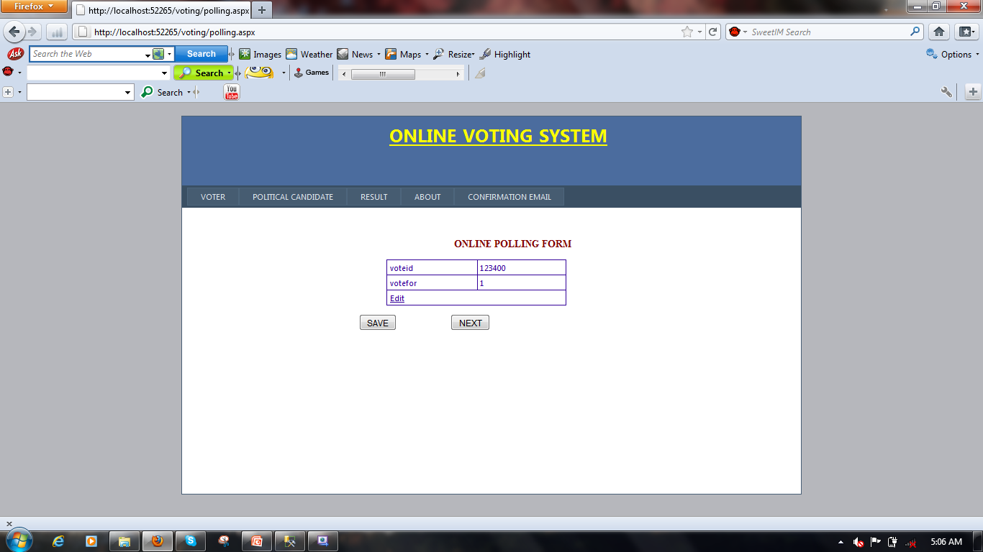
ONLINE VOTING POLLING FORM

Slide 21
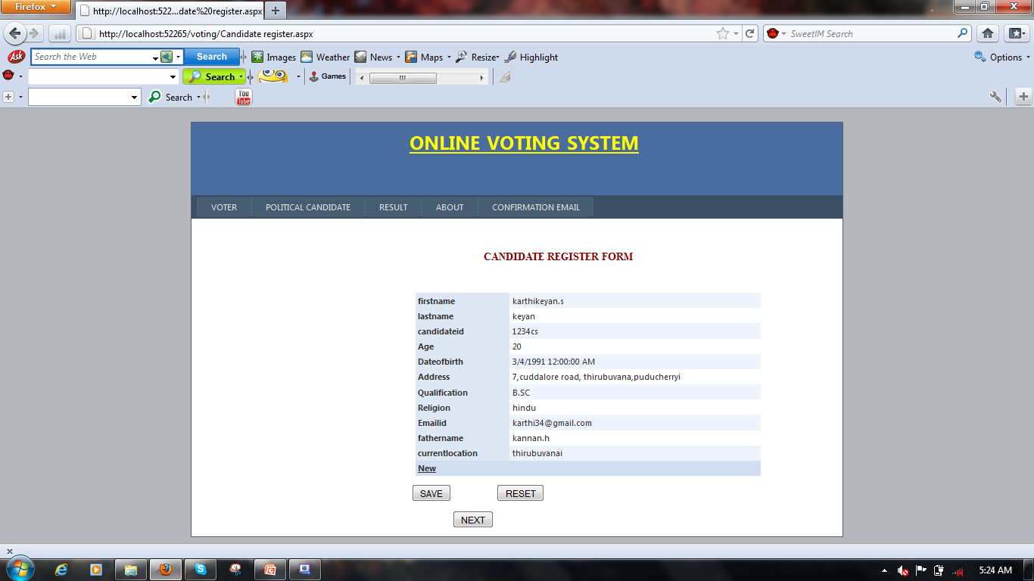
VOTING CANDIDATE INFO FORM

Slide 22
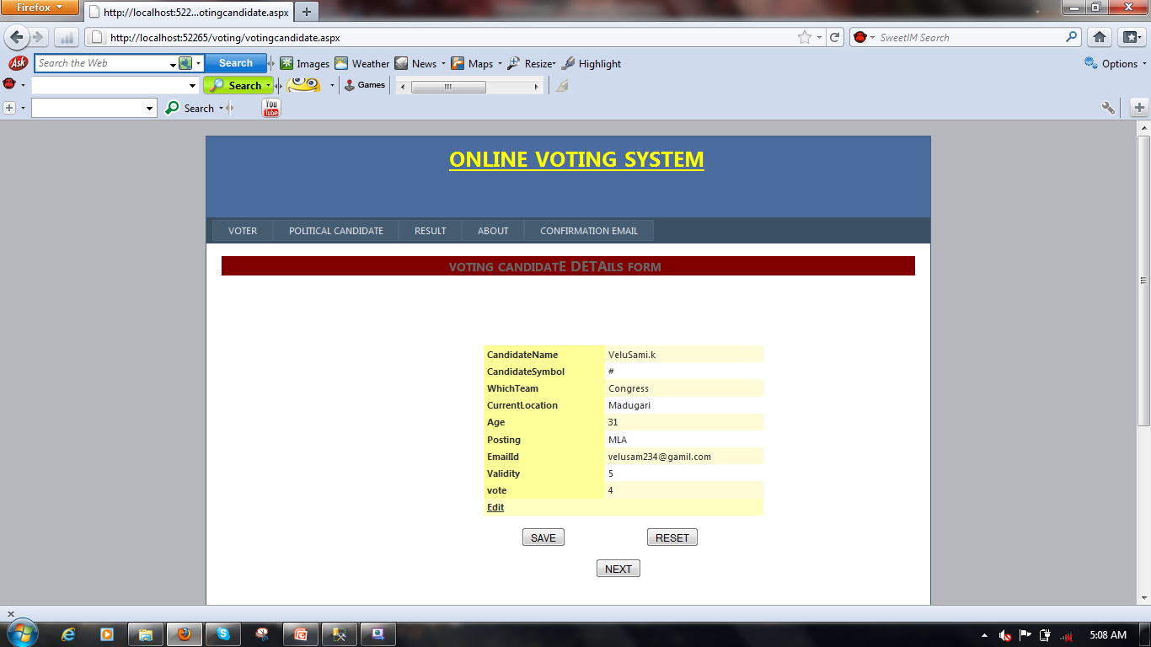
VOTING CANDIDATE DETAIL FORM

Slide 23
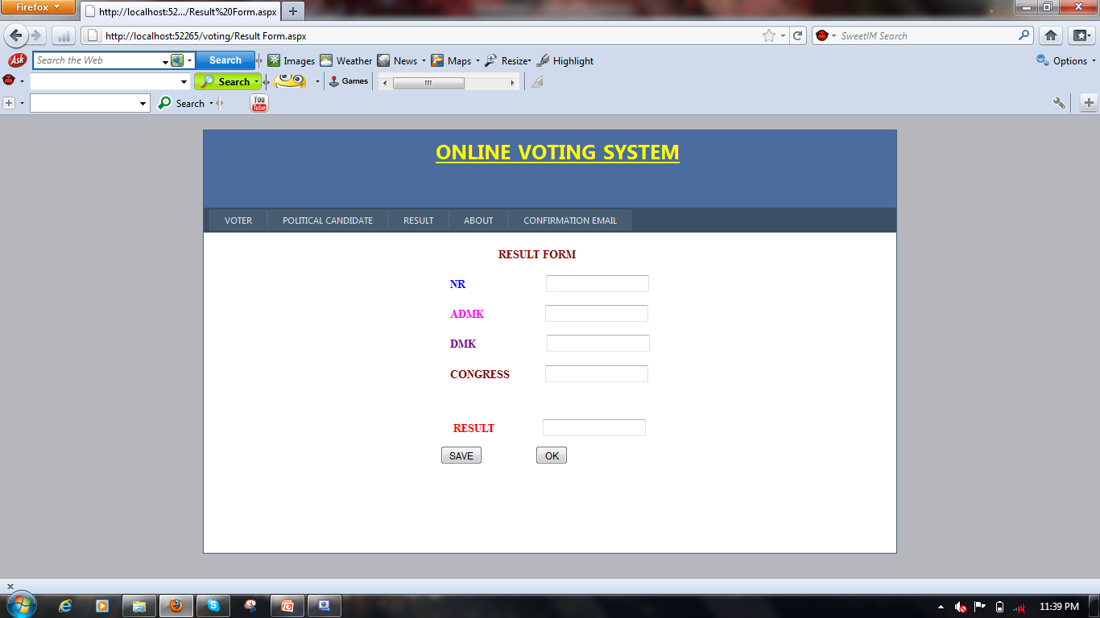
RESULT FORM

Slide 24
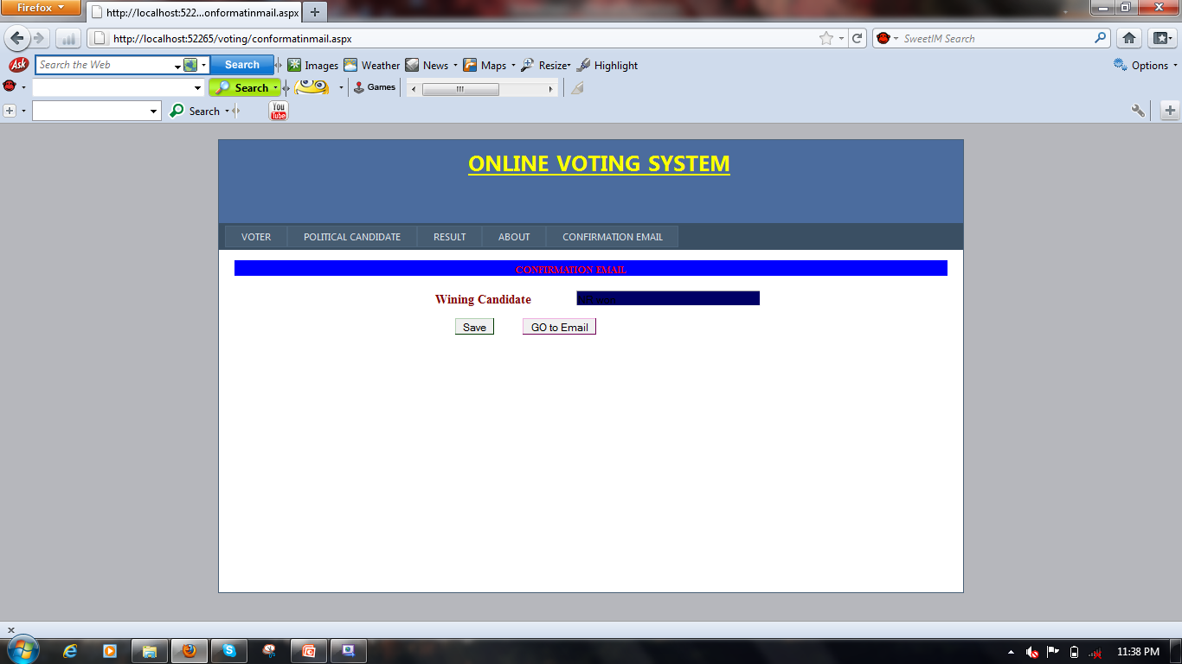
CONFIRMATION E-MAIL

Slide 25
CONCLUSION
Generally voting has to be perform by user by going to the voting center. Many users like army person or NRI cannot come to the voting place.
Therefore we have to implement a online voting system by which the users can vote over the online. It is one of the greatest advantage for NRI and person who go outside the country they can vote on online by our software.

Slide 26
Reference
www.google.com
www.wikipedia.com
www.studymafia.org

Slide 27
Thank You

